Slide 1

Maulana Azad
National Institute of Technology,Bhopal
(Computer Science and Engineering Department)
Minor Project on “Real time Face Mask Detection” under the Guidance of
Prof. Sanyam Shukla
(CSE Department MANIT, Bhopal)
Submitted By:
Shubham Jhalani Sandeep Kumar Mansi Badole Yogesh Kumar Ahirwar
181112077 181112084 181112082 181112089
CSE CSE CSE CSE
MANIT,Bhopal MANIT,Bhopal MANIT,Bhopal MANIT,Bhopal

Slide 2
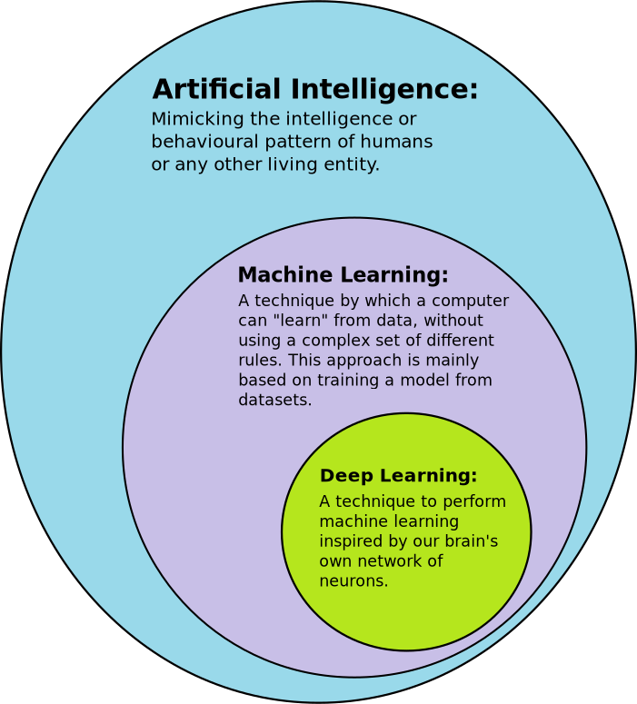

Slide 3
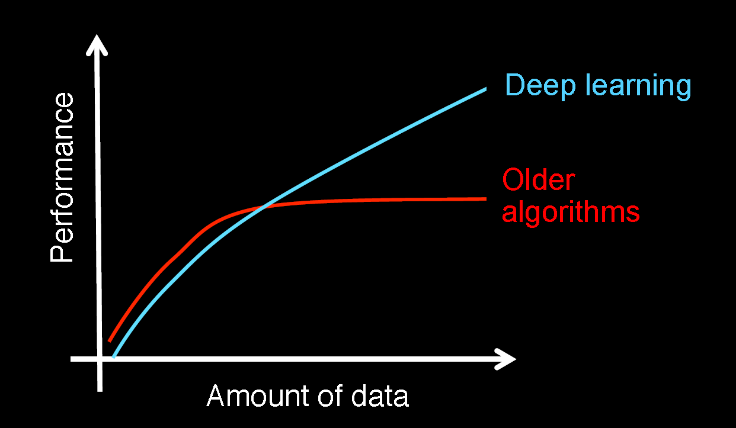
Deep Learning
Deep learning is an AI function that mimics the workings of the human brain in processing data for use in detecting objects, recognizing speech, translating languages, and making decisions.
Why Deep Learning?

Slide 4
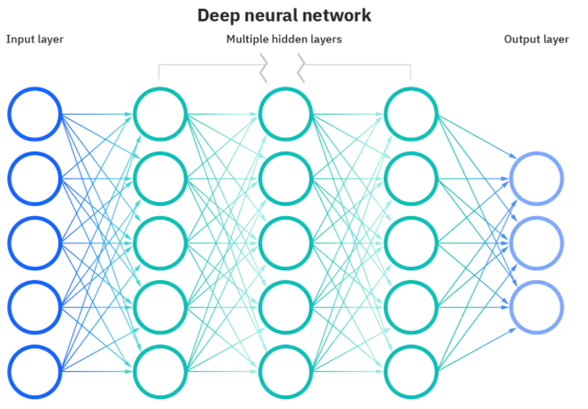
Neural Networks
Artificial Neural Networks (ANN)
Convolution Neural Networks (CNN)
Recurrent Neural Networks (RNN)

Slide 5
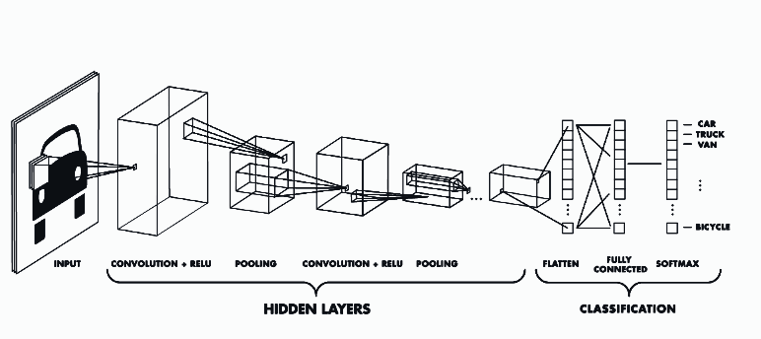
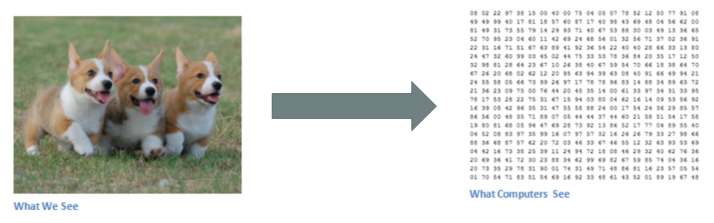
What is CNN
Visualization of Image by Computer

Slide 6
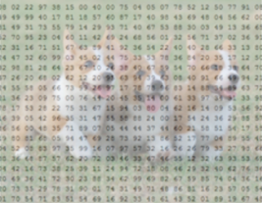
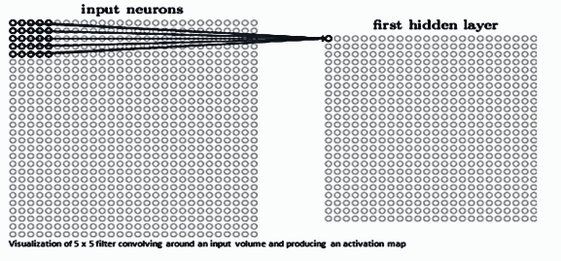
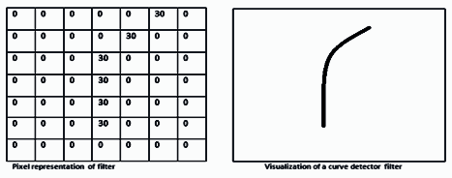
CONTENTS OF CLASSIC CNN
Convolutional Layer
Activation operation following each convolutional layer(Relu Function)
Pooling layer
Flatten layer
Fully Connected layer
Resizing
Kernel / Filter
Visualized Curve

Slide 7

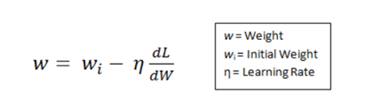
TRAINING
Forward Pass
Loss Function
TESTING
3. Backward Pass
4. Weight Update

Slide 8
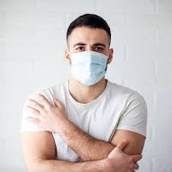
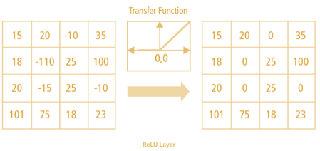
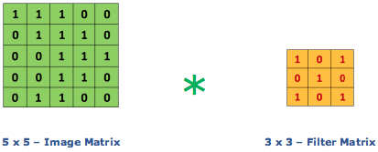
Example:-
Convolution Layer

Slide 9
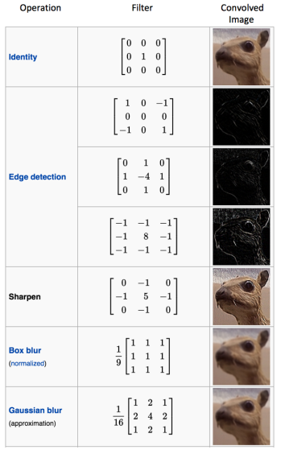
Some different types of Filters
used for different purposes

Slide 10
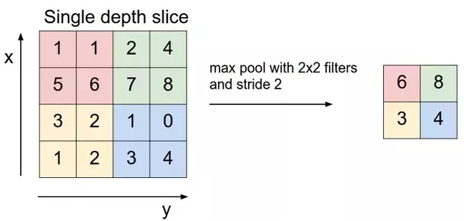
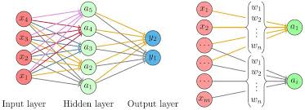
Max Pooling
Fully Connected Layer

Slide 11
Artificial Neural Networks
ANN is a ML approach inspired by way in which brain perform a particular task. It actually mimic the human brain.
Connecting Links with weights.
Adder Function (Linear Combiner)Σwjxj+Bias(b)
Activation Function y = ф(u+b)

Slide 12
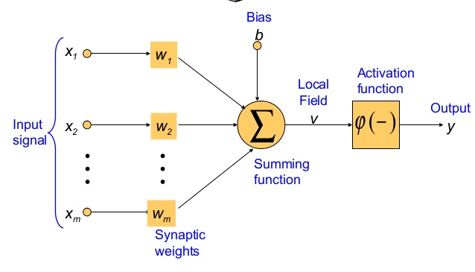
Artificial Neural Networks

Slide 13
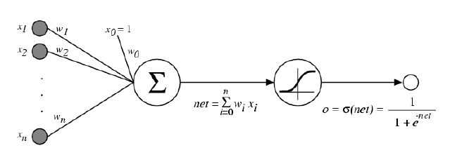
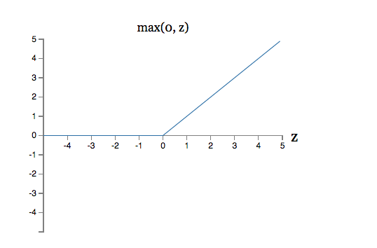
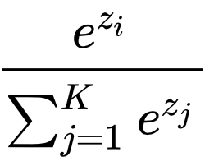


Activation Functions
Sigmoid Activation
ReLU Activation
Softmax Activation

Slide 14
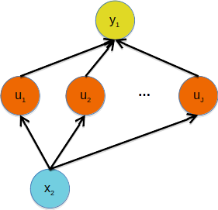
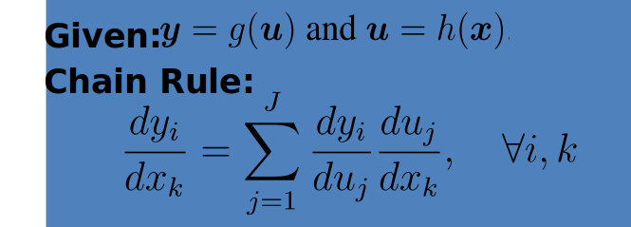
Backpropagation
Provides an efficient way to compute gradients and it is a special case of reverse-mode automatic differentiation

Slide 15
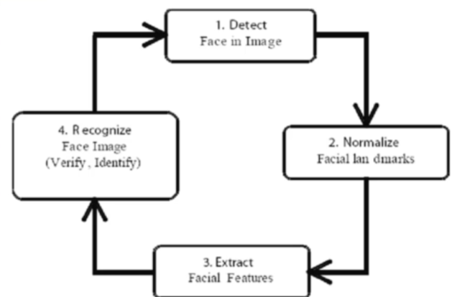
Face Recognition
A facial recognition system is a technology capable of matching a human face from a digital image or a video frame against a database of faces, typically employed to authenticate users through ID verification services, works by pinpointing and measuring facial features from a given image
Face Recognition basically involves four steps:
Face Detection
Face Alignment
Feature Extraction
Face Recognition

Slide 16
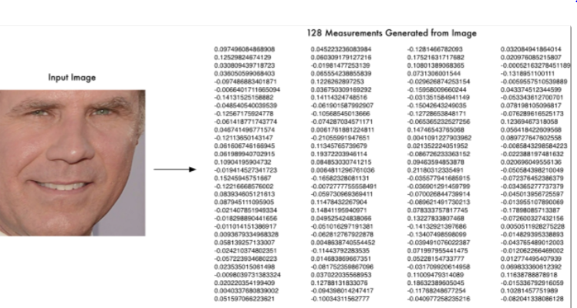
Face Detection
Face detection is the process of automatically locating human faces in visual media (Digital Image and Video)
Two Popular type of face detectors face_recognition library supports
HoG Face Detector
CNN based Face Detector included in Dlib
Here we have used HoG Face Detector due to the CPU but for more accuracy and availability of GPU, we can use CNN based Face Detector

Slide 17
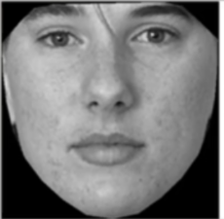
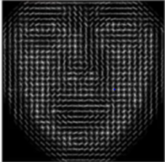
HoG FACE DETECTOR
A HoG is generally used for object detection
A HoG relies on distribution of intensity gradients or edge direction
PROS
Faster while using in CPU
Works under small occlusion
CONS
Min size of face should be 80*80 px
Doesn’t work for side face or high extremes of non frontal faces like looking up and down
Doesn’t work under heavy occlusion (sunglasses, hat/cap, scarf etc. )

Slide 18
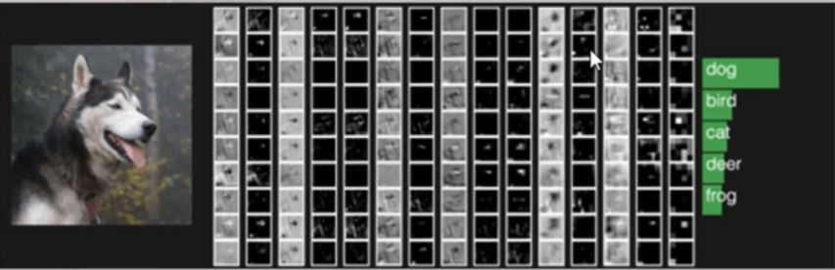
CNN Face Detector in Dlib
This method uses Object Detector with CNN based features.
The training process is simple. No need for a large amount of training data.
Pros
Detect Multiple Face orientations
Works with medium occlusion
Fast on GPU
Cons
Very slow on CPU

Slide 19
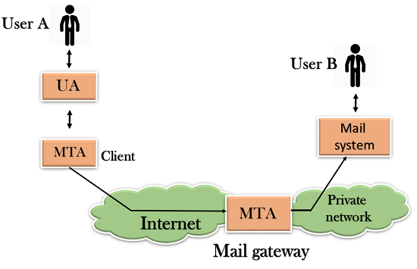
SMTP (SIMPLE MAIL TRANSFER PROTOCOL)
SMTP is a set of communication guideline that allows a software to transmit an e-mail over the internet using port number 465 and 587.
It provide email exchange between users of same or different computers.
Its main purpose is to set up communication rules between servers. The servers have a way of identifying themselves and announcing what kind of communication they are trying to perform.

Slide 20
Libraries Used
NumPy : For Numerical Computation
Pandas : For Importing Files
Tensorflow : Used as Backend to run the program
Keras : To Implement the CNN Libraries and Image Processing
.models : To initialise the CNN
.layers : To Implement all layers (Convolution, MaxPooling, Flatten,
Fully Connected Layer)
.callbacks : To store the model result at epoch for further use(ModelCheckpoint)
.preprocessing : Used to Process the images, text etc.
. image : Used to Process images
openCV : To be Used for Live interaction to user(Enable Webcam to detect mask)
dlib : It’s C++ toolkit use for facial and its landmark detection
Face_recognition : Used to recognise face using dlib’s face recognition feature.
Pickle : Used to dump or extract variables in memory.
Smtplib : Used to Send email to the person.
Csv : Used to read/write data in csv file
Os : Used for some os command directly in pyhton

Slide 21
Language To Be Used
Python : version(3.8) is used.
Software To Be Used
Spyder : version (4.1.4) to run the Python Program installed via Anaconda.
As it’s a python file can be run on any python Software(like
PyCharm, Sublime text, Jupyter Notebook etc.)

Slide 22
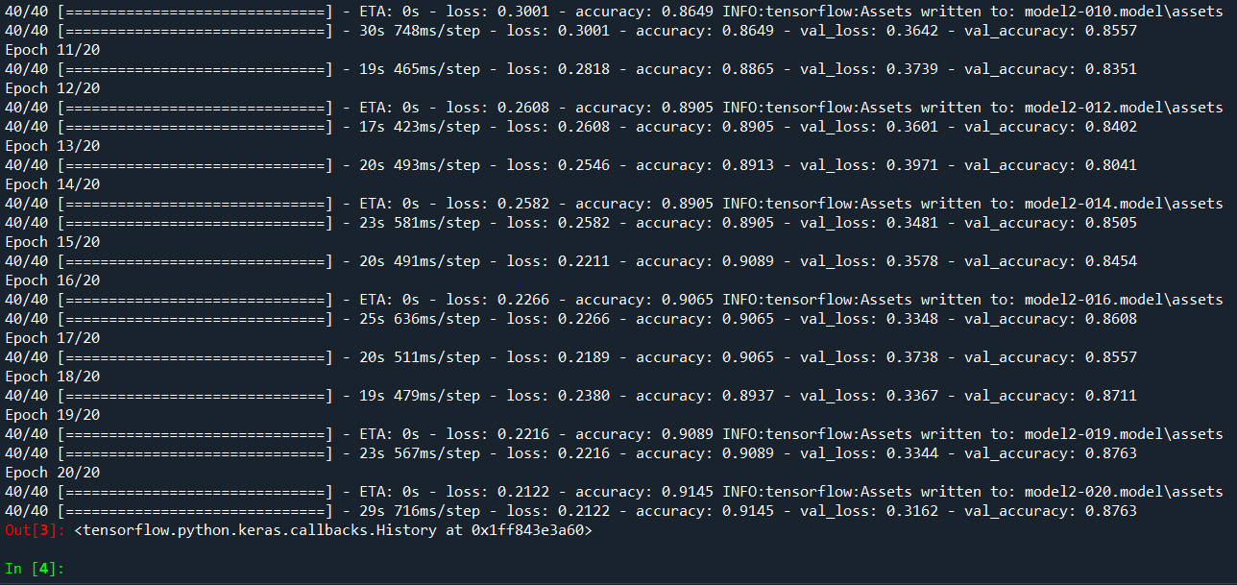
SCREENSHOT OF THE OUTPUT
We got accuracy of 91% on Training Set and 88% on the Test Set.

Slide 23
Thank You

